Slide 1



Solar Radiation Prediction
Mohit Matta
Ramakrishna Danda

Slide 2
Goal Summary
How- Explore and predict solar radiations using below distinct machine learning techniques:
Logistic Regression
Random Forest Regression
Support Vector Machine Regression
XGradient Boost Regression
Neural Network Regression
What -To discover which statistical and machine learning techniques supply the best short-term predictions of solar radiance given historical weather data representing atmospheric conditions
Why
Energy Producers- Balance demand and supply by accurate prediction, minimize operational costs
Environment- Check the effect of global warming at geo locations and study cause and effect relationship with atmospheric variables, minimize pollution
Health- Check and identify radiation thresholds of geo locations for health safety
Predict possibilities of energy generations at residential places with similar or different atmospheric conditions

Slide 3
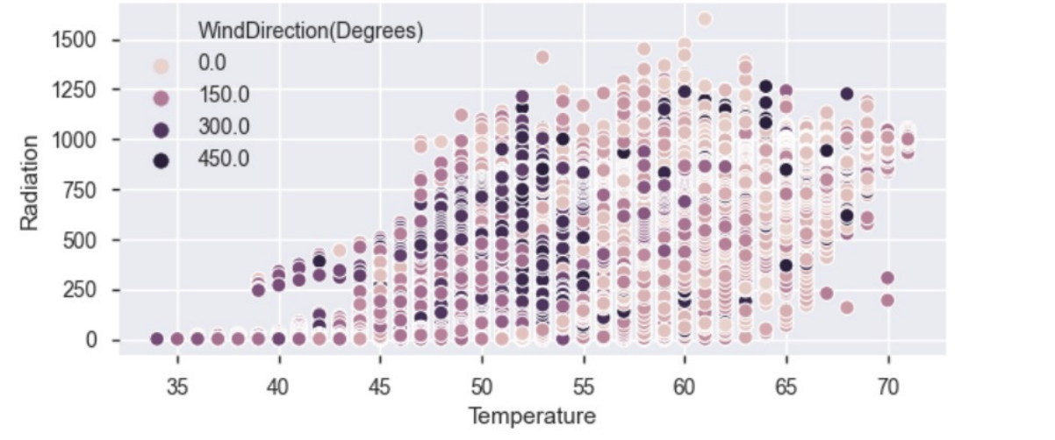
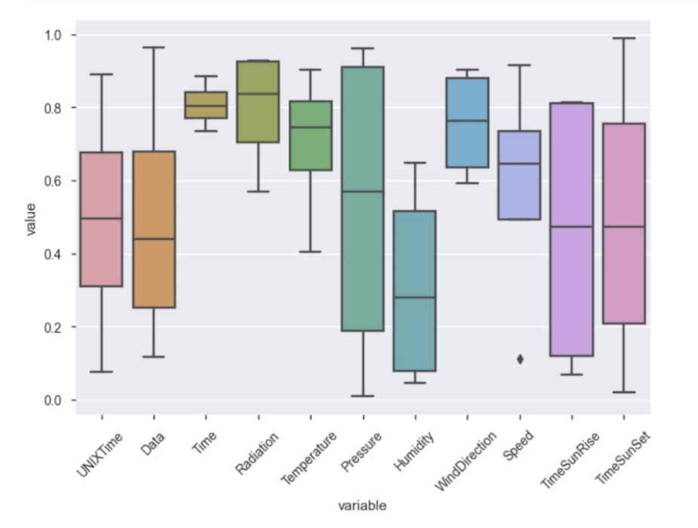
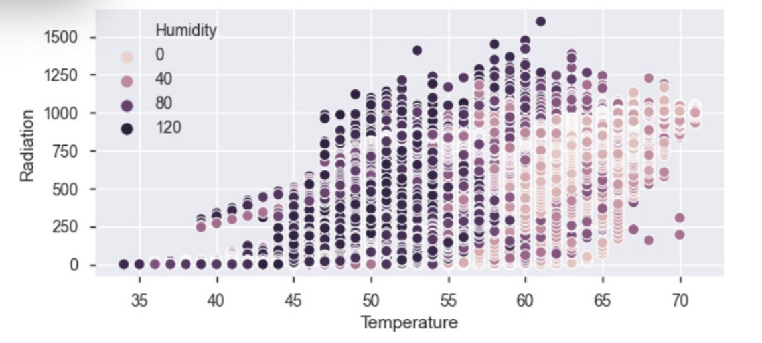
Exploratory Data Analysis : Data Visualization
Fig2: Wind direction has no effect on Radiation when Temperatures goes beyond 55
Fig1: box-and-whisker
Pressure and Time SunRise has the largest effect on radiation with no outliers with in the inter quartile range variability.
Fig3: Humidity has slight edge of an effect on radiation but not significant when temp above 60

Slide 4
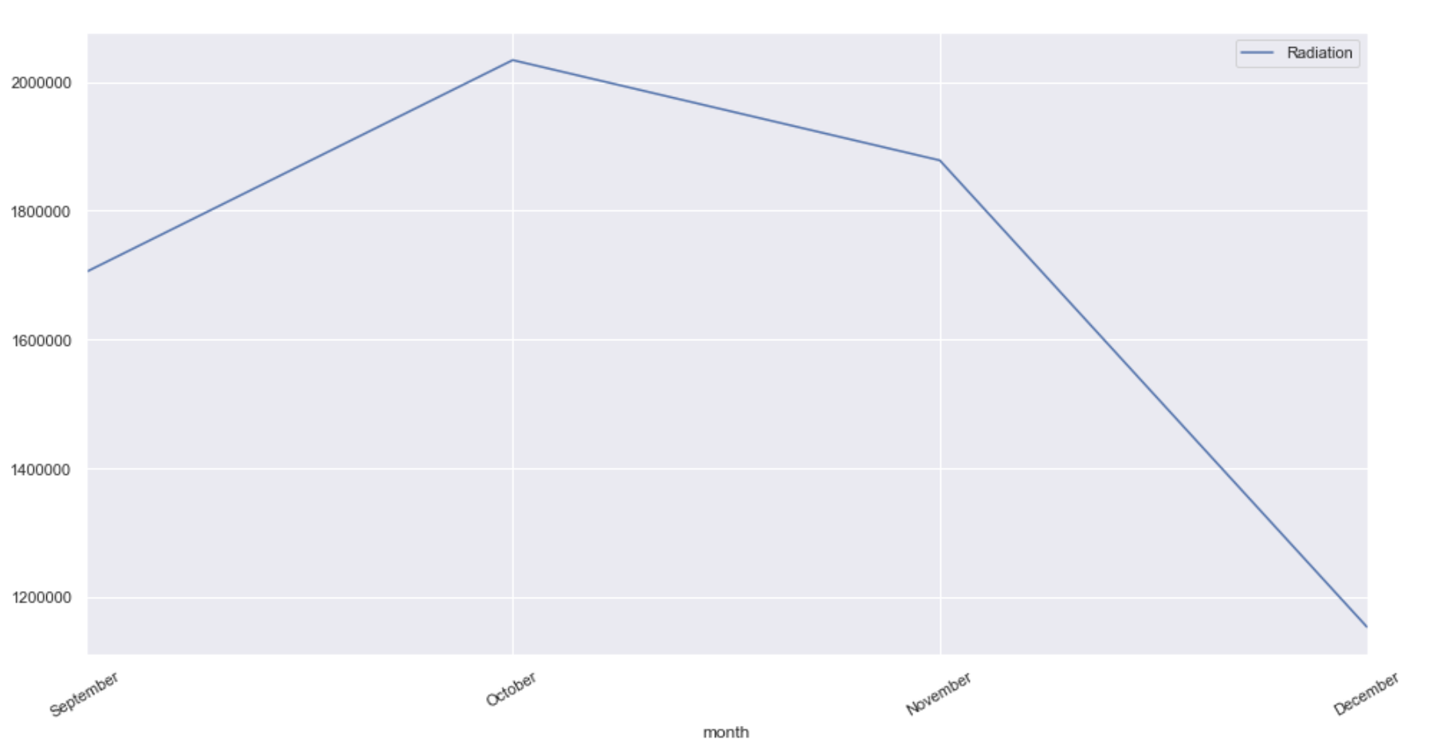
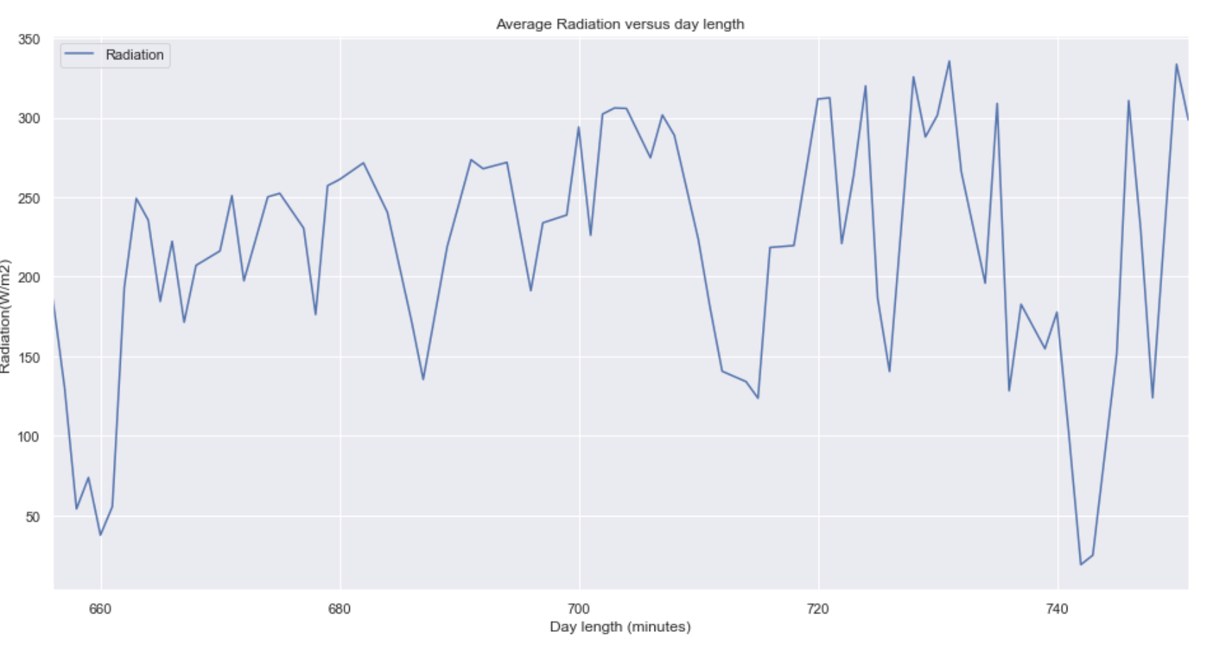
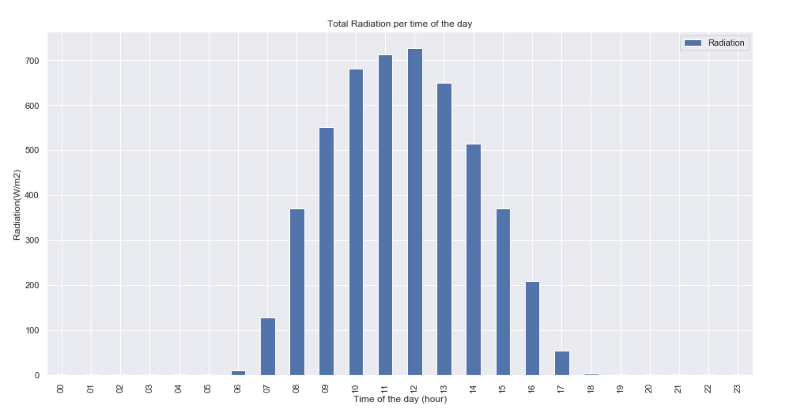
Exploratory Data Analysis : Data Visualization
Fig5: Month vs Radiation: 3 months is very less data to conclude relation with radiation
Fig4: Average Radiation Vs Day Length: Most Radiation is captured when day length is between 680 and 740 minutes
Fig 6 : Average Radiation Vs Time of day shows radiations are highest during
afternoon hours when temperature is maximum

Slide 5
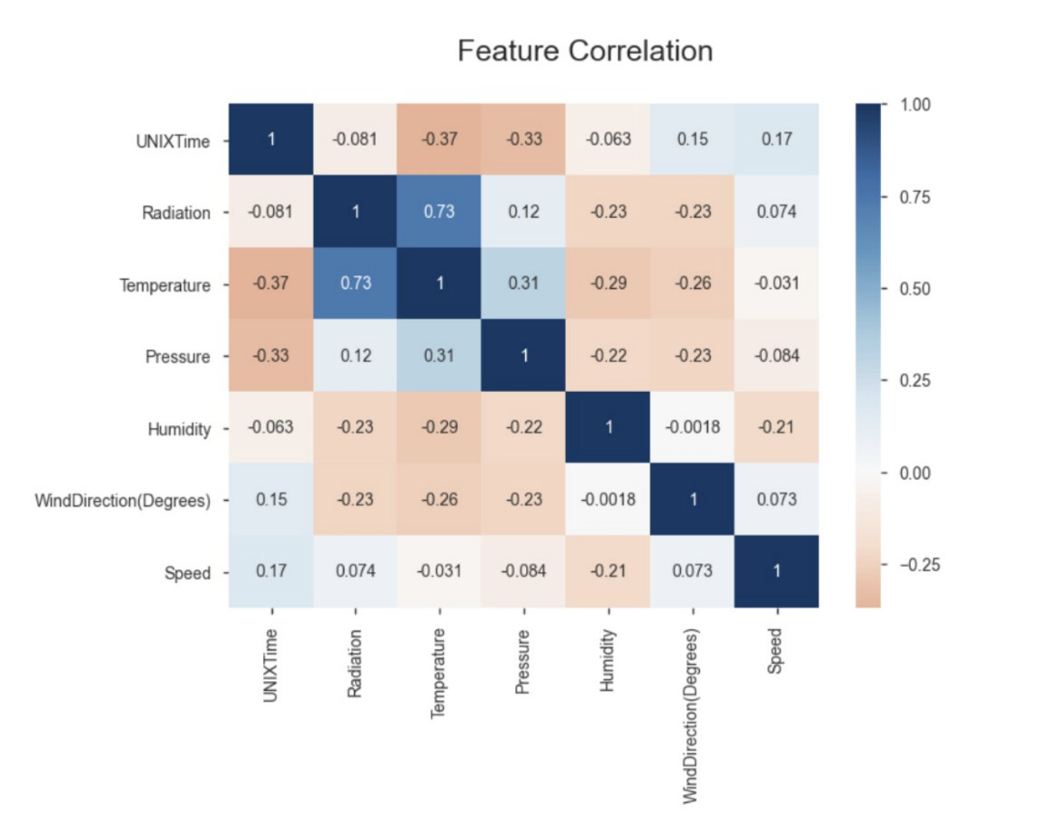
Exploratory Data Analysis : Feature Correlation
Radiation is positively correlated with Temperature
Radiation is slightly positively correlated with Atmospheric Pressure
Radiation is weakly correlated to Humidity,Wind Direction and Wind speed

Slide 6
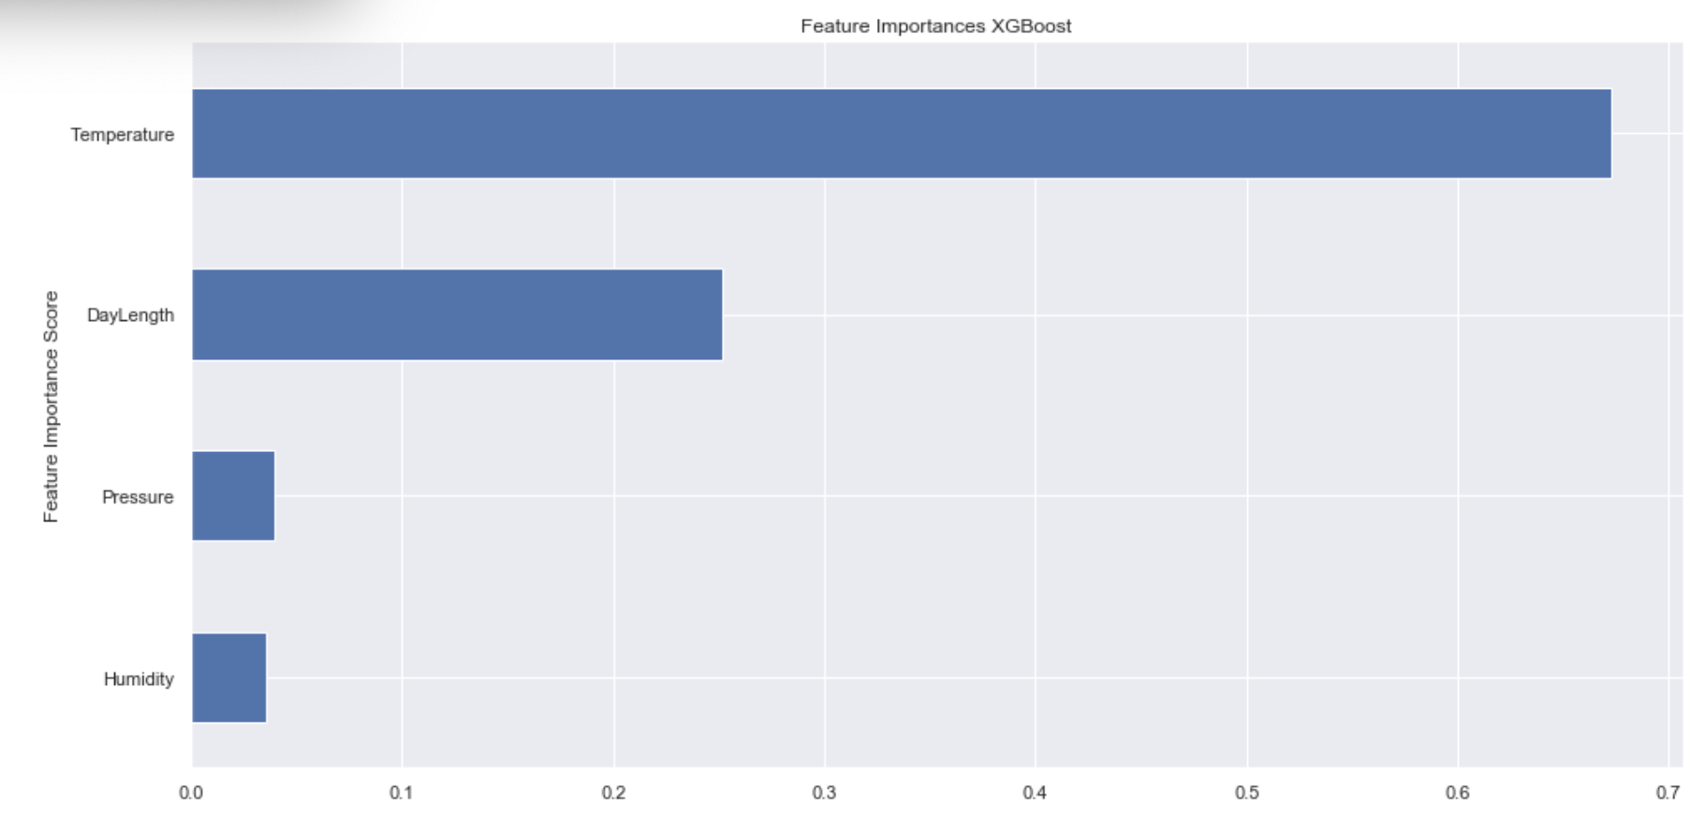

Exploratory Data Analysis : Feature Importance based on feature score
Fig7: Temperature feature has the clear advantage along with daylength to be used as independent variables.

Slide 7

Machine Learning: Forecasting
Logistic Regression
Random Forest Regression
Support Vector Machine Regression
XGradient Boost Regression
Neural Network Regression

Slide 8
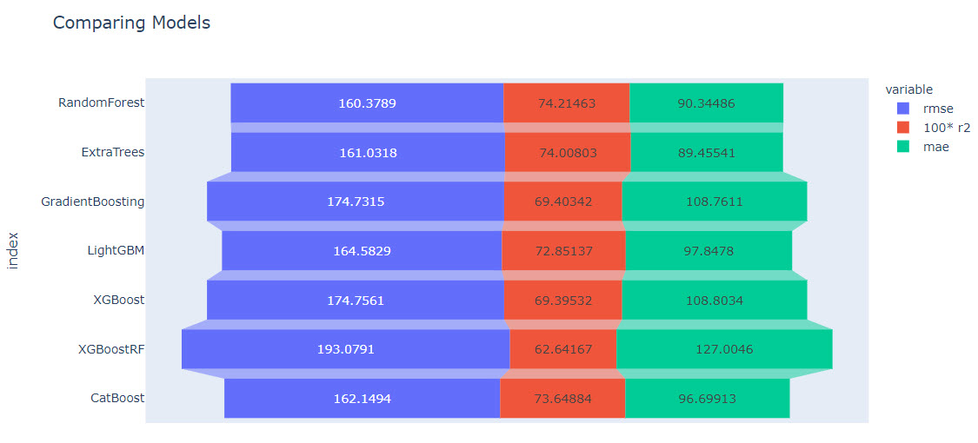
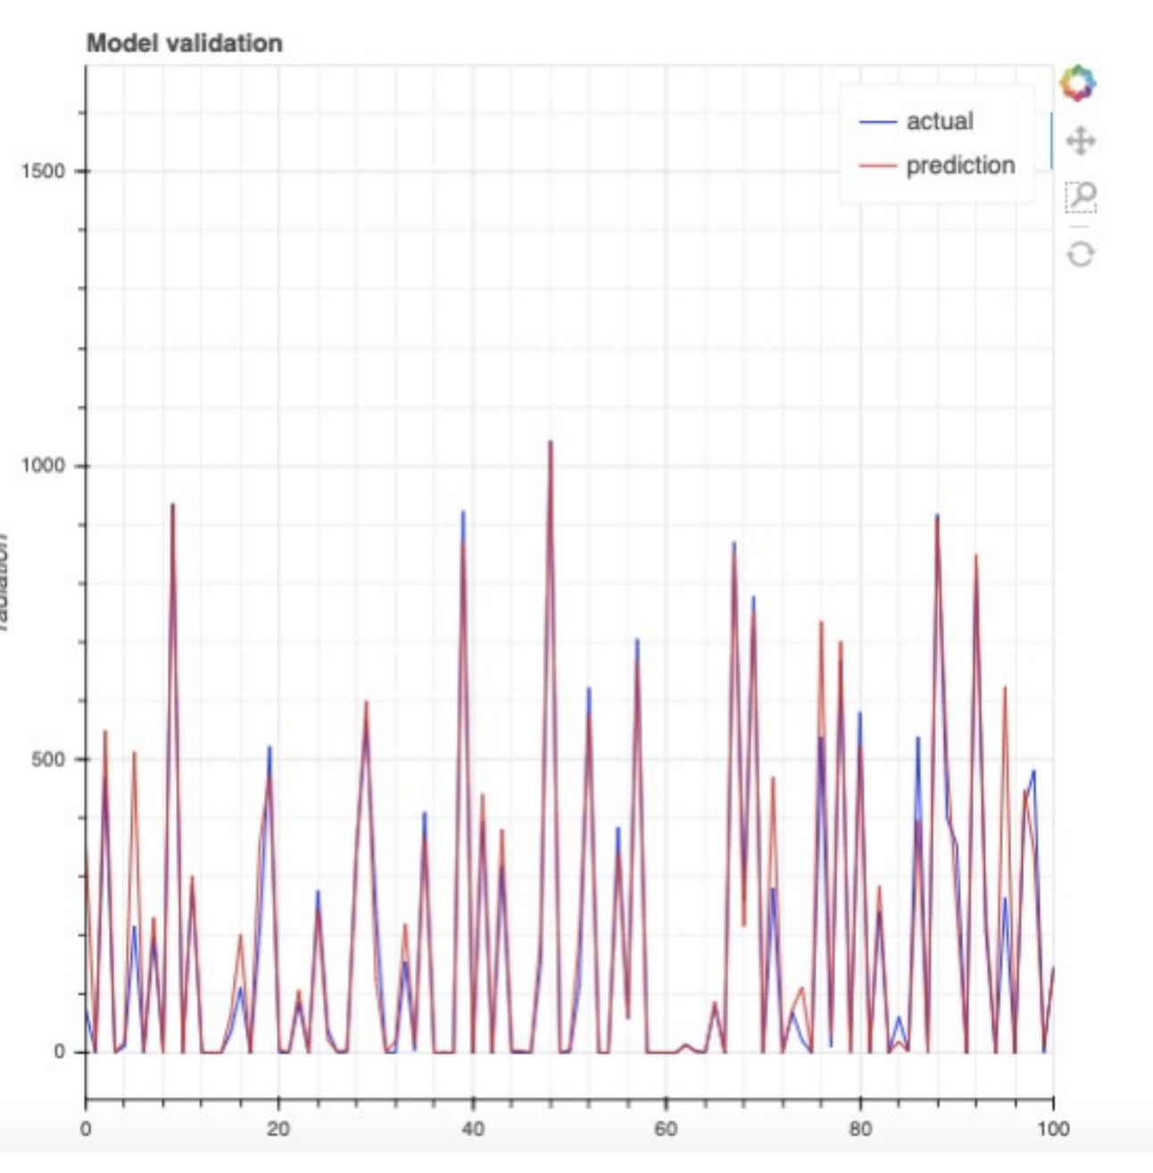
Machine Learning: Model Comparison
Fig8:compared against each other, XGradient Boost has best performing model with R-Squared value of 0.81.
Fig9: Actual vs prediction validation inline with R-Squared at 0.81

Slide 9
Conclusion
RMSE, R-Squared and MAE values were compared for all models, XGradient Boost seemed to be the best performing model without extracting best features with R-Squared value of 0.81.
After tuning the parameters and applying feature reduction for random forest regression model, we were able to achieve the lowest mean square error of 0.70 and most of the predicted values feel close to actual values.
Some of effects of cloud coverage and rain is ignored directly, they may still be indirectly playing role through temperature and humidity.

Slide 10
Applications and Tools
For exploration, dataset and model creation:
Jupyter Notebook
Python,pandas, numpy,matplotlib,
seaborn,sklearn,pytz,plotly,scipy,keras, xgboost

